Slide 1
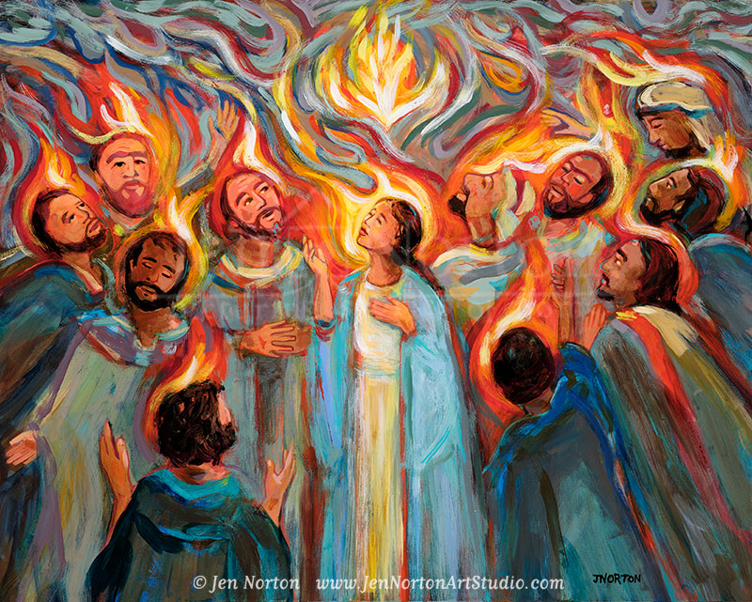
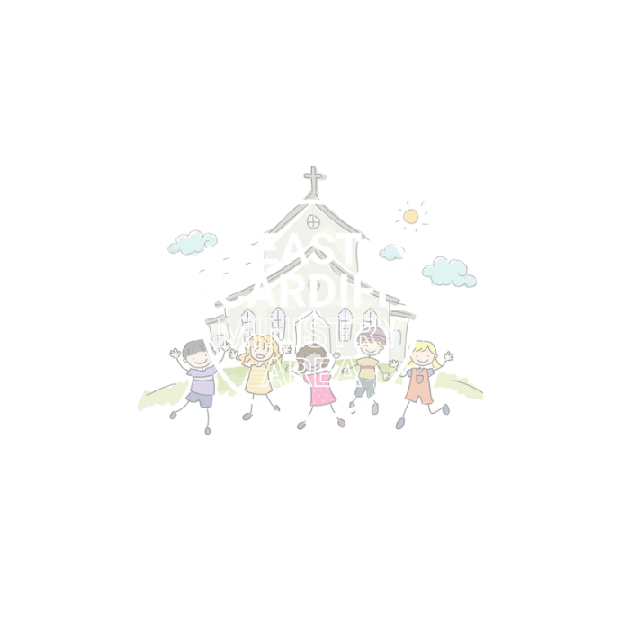
Pentecost
Monmouth diocesan vision:
Discipleship
Adapted from: https://www.assemblies.org.uk/pri/3514/fire-at-pentecost

Slide 2
What words come to mind when we think of the word 'fire'?

Slide 3
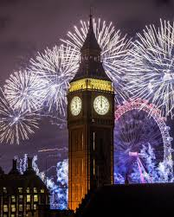
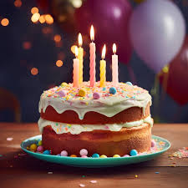
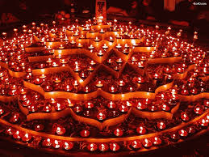
Can you think of happy events where fire might be be part of our celebrations?
Remember fire can be dangerous so only adults should be incharge of lighting fires and fireworks etc.

Slide 4
Christians sometimes use fire as a way of imagining God. Watch the following story of the coming of the Holy Spirit to Jesus’ disciples at Pentecost.

Slide 5
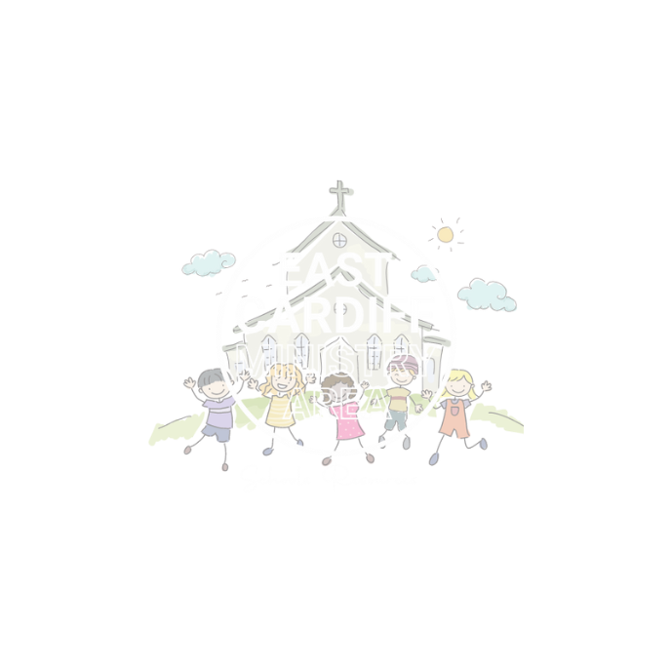

Slide 6
Can you think of examples of these gifts?
For example:
Right Judgement – Asking if you can have a sweet treat rather just taking it even though you REALLY want it.

Slide 7
Let us pray
The Bible describes the Holy Spirit in different ways. It speaks about the Spirit being strong like the wind, but gentle like a dove and as bright, warming and powerful as fire.
Listen to the music and think about all the ways that you see these gifts of the spirit in your lives.
The Music is called Veni Sancte Spiritus it means
come holy spirit and is often sung or prayed
at special services like when people become priests.

