Slide 1
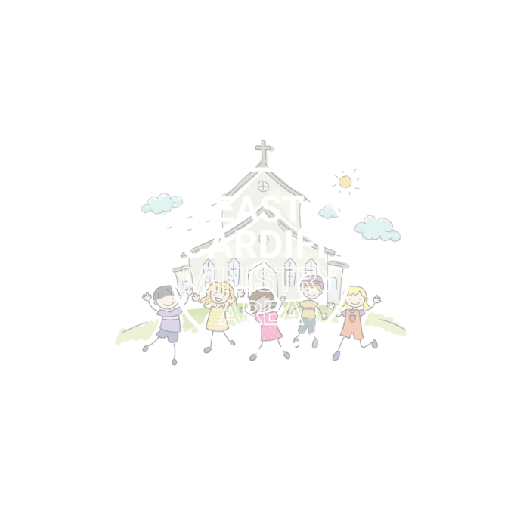
Speak Up
Living and growing
Monmouth diocesan vision:
social justice
UN Convention of the rights of the child: aRTICLE 6 (The right to live and grow)

Slide 2
We all have the right to live and grow without fear.
What do we need to live and grow?
watch the video of a tree growing over many years to help you think of an answer.

Slide 4
What do you think the tree needs to live, grow and flourish where it is planted?

Slide 5
What do you need to live, grow and flourish?

Slide 6
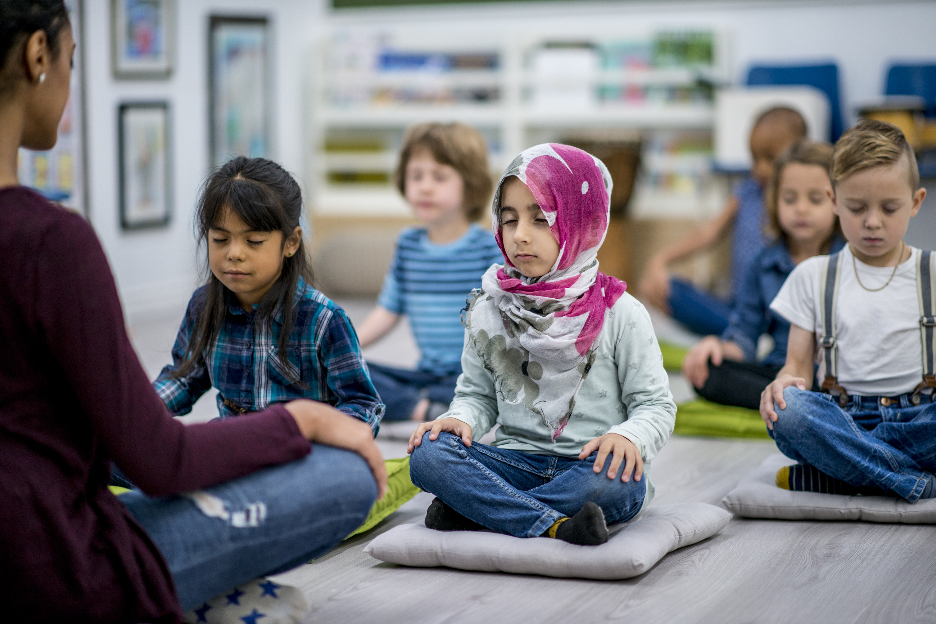
Let us pray
Imagine the people who make you feel safe and help you to grow and flourish. Imagine a lovely warm, happy light around them and in your head say thank you to them. (Maybe you can thank them in person later)
Lord of creation. Lift me up when I am unjustly treated. Forgive me when I act unjustly. Give me courage to speak up for those who are powerless.
Save me from believing that change is not possible, Amen

Slide 7
