Slide 1
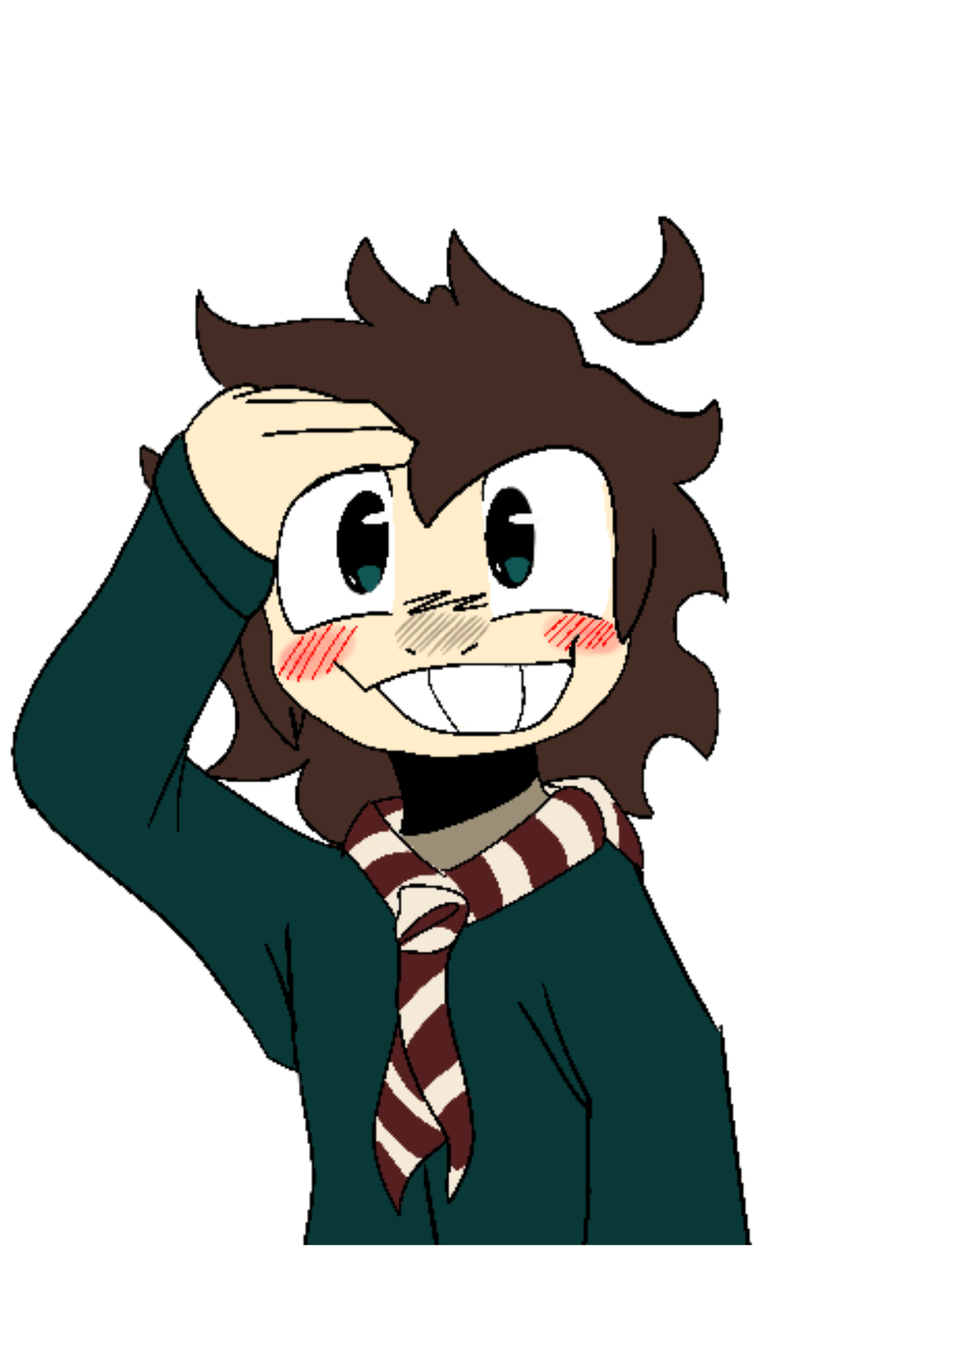
Lent
Adapted From:
https://www.assemblies.org.uk/pri/1614/the-christian-festival-of-lent

Slide 2
GIVE US A CLUE!
WHAT DID YOU DO BEFORE YOU CAME TO SCHOOL TODAY?

Slide 3
BE PREPARED!

Slide 4
DISCUSS
What preparations would you need to make for the following events?
Going on holiday.
A school play.
A party.

Slide 5
Just like we prepare for special events, so many Christians prepare for Easter by observing Lent.

Slide 7
DISCUSS
Can you think of something special that you could do during Lent that would help someone else?

Slide 8
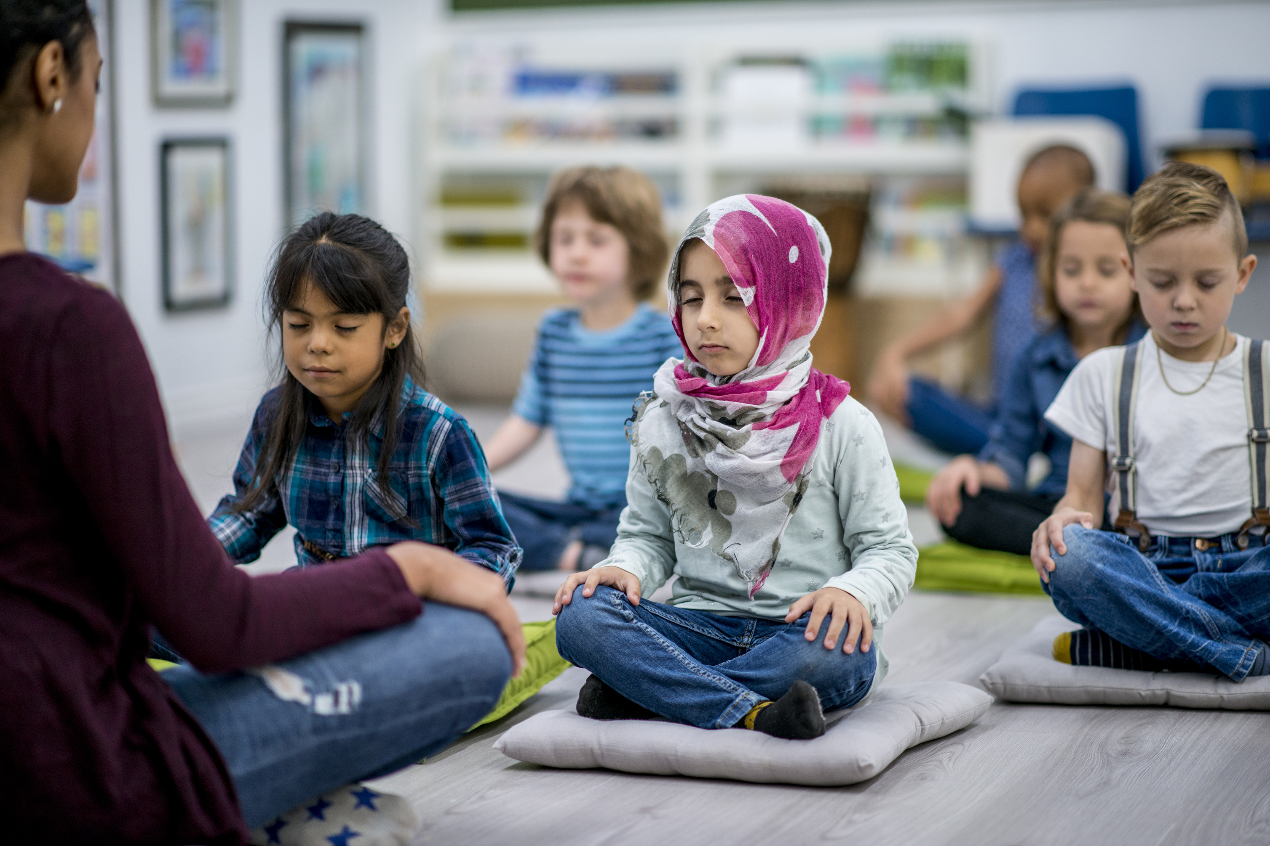
LET US PRAY
Teach us Lord, to heal and not to injure;
to cherish people and not to harm them.
Nurture within us the gifts you have planted
so that we might be the people
you are calling us to become.
In Jesus' name.
Amen
Prayer of St Teilo by Fr Gareth Rayner William (adapted)

