Slide 1
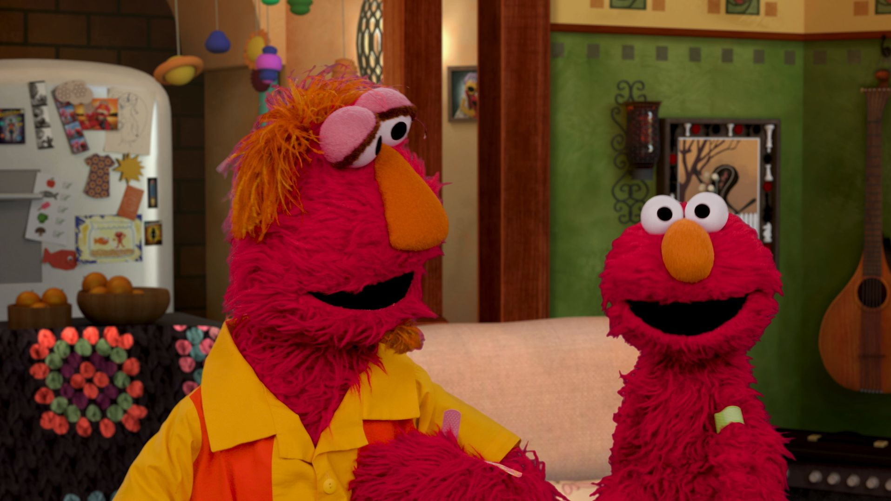
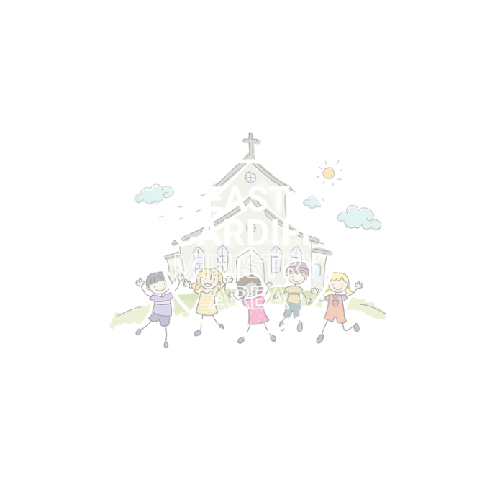
Speak Up
I Notice
I feel
I can
Monmouth diocesan vision:
social justice
UN Convention of the rights of the child: aRTICLE 13 (FREEDOM OF EXPRESSION)

Slide 2
We all have the right to express how we are feeling and if somebody has upset us.

Slide 3
It can be really hard to talk about our feelings, especially if they are new or difficult to describe.

Slide 4
https://youtu.be/JwmnHOzytIU?si=rOwikIuHUoJK9yUQ

Slide 5
Let’s put this into practice…
Imagine two friends have been running in a race. Both have done their best but one won and one didn’t.
The friend that lost snapped at the winning friend and told them to GO AWAY.
Let’s use ‘I notice, I feel, I can’ to help us to solve this situation and ensure that both friends can freely tell each other how they feel.

Slide 6
I notice
When something triggers a big emotion it can be hard to work it out.
If the friends pause, what might they notice about their bodies and the situation they are in.
E.g. Are they feeling breathless after running? Is it very noisy? Are there lots of people around?

Slide 7
I Feel
Although we may not understand the name of big feeling, often a big feeling is just a snowball made up of lots of smaller feelings.
If the friends pause, they can think about how they are feeling. What feelings do you think they might be feeling?
E.g. Is one friend feeling disappointed that they didn’t come first?

Slide 8
I can
Once we have thought about what we have noticed we can think abot what we can do to help ourselves.
How can the friends help themselves and each other to understand the other's point of view.

Slide 9
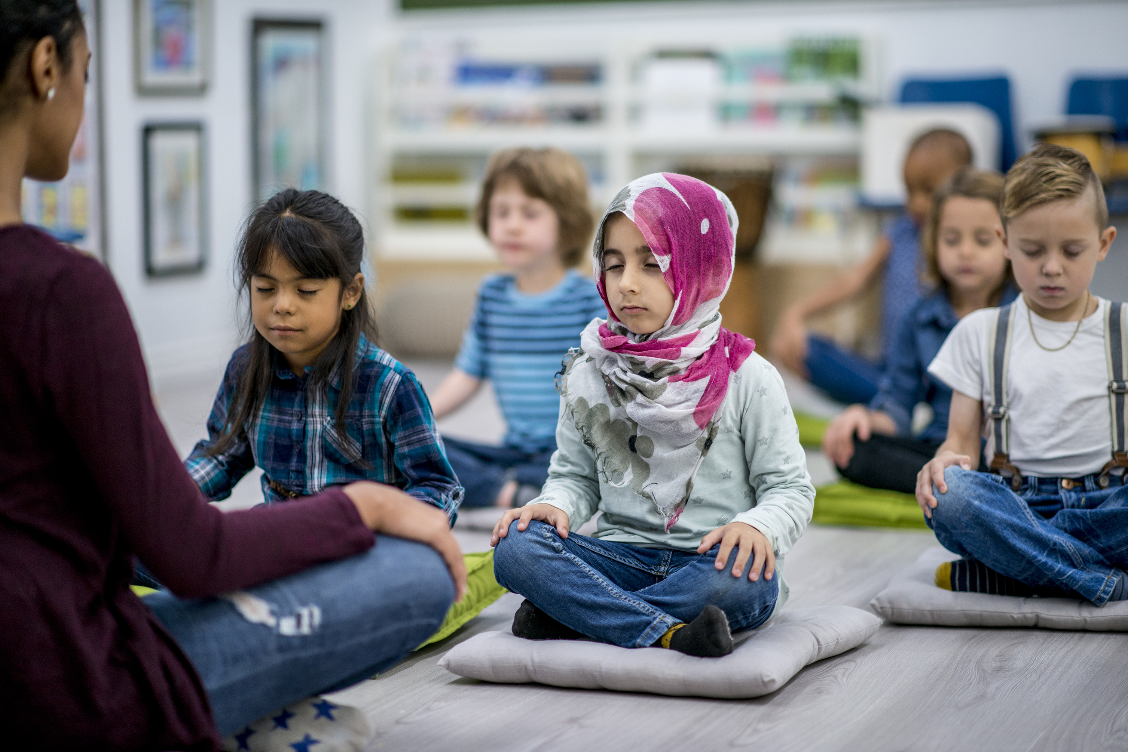
Let us pray
Imagine the big and small ways in which you show courage every day.
Lord of creation. Lift me up when I am unjustly treated. Forgive me when I act unjustly. Give me courage to speak up for those who are powerless.
Save me from believing that change is not possible, amen

