Slide 1
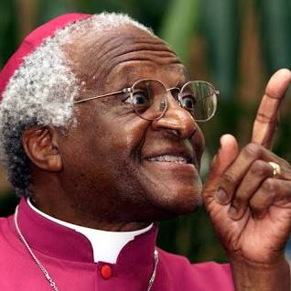
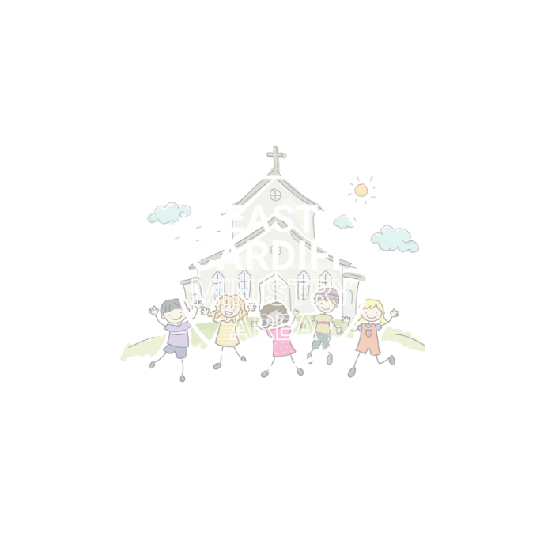
Lift Others Up:
Respect
Monmouth diocesan vision: Discipleship

Slide 2
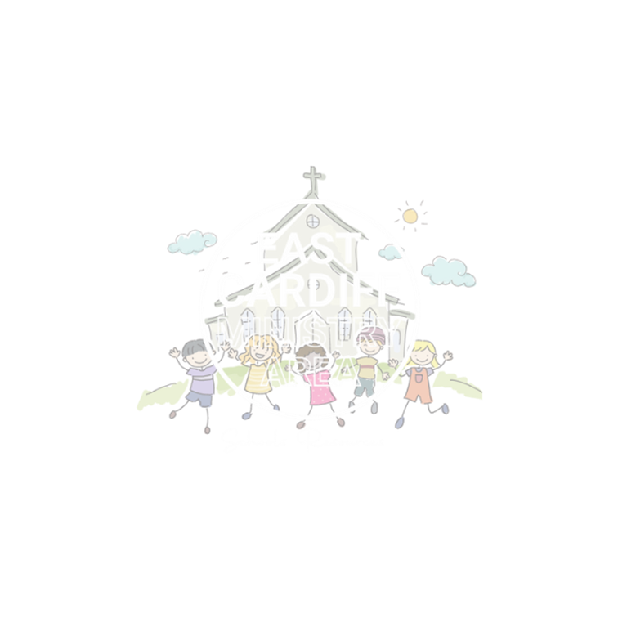
If you think the following statements are true put your hands on your head. If you think they are false put your hands in the air.
Chocolate is the best ice cream flavour
Dogs are better than cats
Spiders are scary
I love dancing!
This game is adapted from:https://www.educateagainsthate.com/resources/

Slide 3
DISCUSS
Was there a right or wrong answer to any of these questions?
Did everybody have the same answer?

Slide 4
DISCUSS
Thinking about the game we just played, what does the game teach us about respecting each other?

Slide 5
Archbishop Desmond Tutu
Archbishop Desmond Tutu was a South African bishop and civil rights activist.
He lived and worked in Johannesburg in the 1980’s. In South Africa at this time black people and white people were treated very differently. Black people were often treated badly because of the colour of their skin. In South Africa there was a name for this, it was called Apartheid.
Archbishop Tutu worked very hard to try to defeat the evils of Apartheid and he spoke a great deal about how much God rejoices when people show each other respect and love.

Slide 6
https://youtu.be/aEppeXmJlJE?si=CEcuHQWy1dQApCXZ
Early years/KS1

Slide 7
https://youtu.be/44xbZ8MN1uk?si=prn45EmKEfQRFe3u
KS 2+

Slide 8
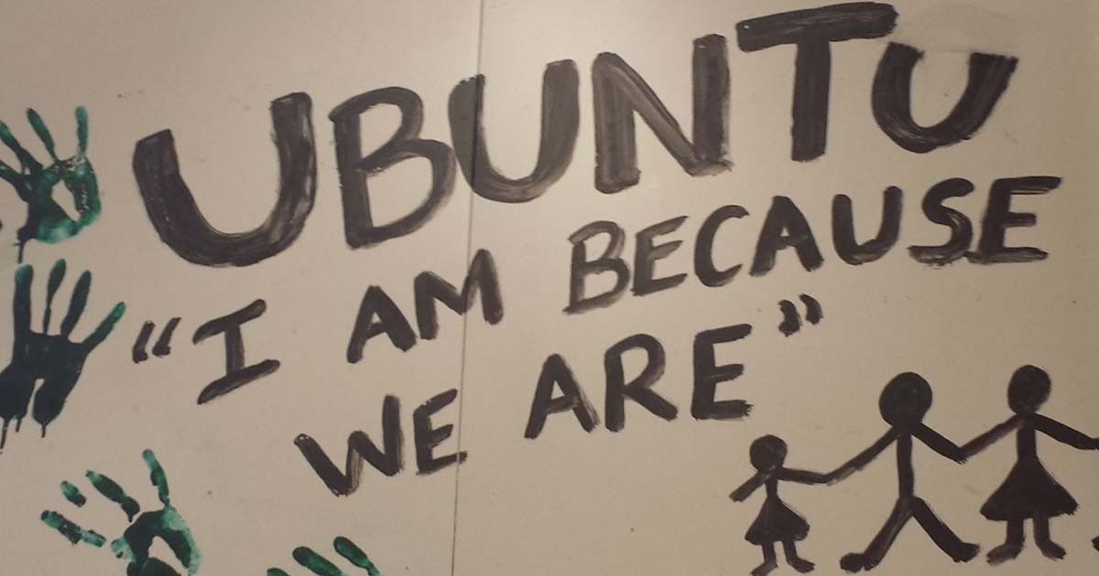
Ubuntu is a South African word that means we are all connected.
For example, if you treat someone with kindness they are more likely to treat somebody else with kindness and the kindness spreads.
‘My Humanity is bound up in your humanity’
The Bible says love the lord your God with all your heart … and love your neighbour as yourself.
How do we demonstrate Ubuntu (great respect) in our communities?

Slide 9
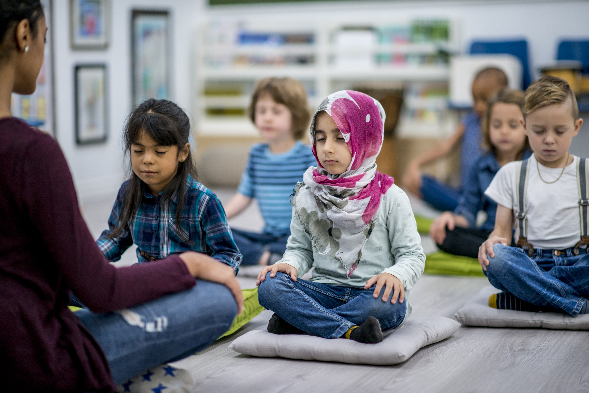
LET US PRAY
Teach us Lord, to heal and not to injure;
to cherish people and not to harm them.
Nurture within us the gifts you have planted
so that we might be the people
you are calling us to become.
In Jesus' name.
Amen
Prayer of St Teilo by Fr Gareth Rayner William (adapted)

