Slide 1
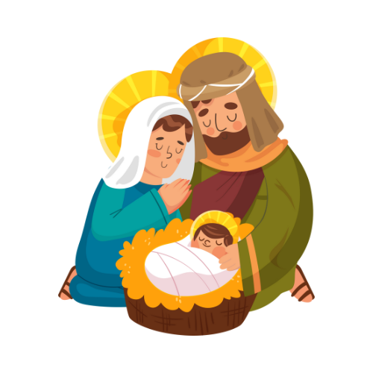
Christmas
Eucharist
School Name

Slide 2
Song:

Slide 3
Priest
God our Father,
the birth of Jesus makes us so happy.
As we gather together to share in this Eucharist,
may we be filled with the song of the angels, the joy of the shepherds and the wonder of the Magi so that we will share our happiness with others
and to live as your children in the world.
Through Jesus Christ our Lord. Amen.

Slide 4
Priest
We take a moment to think about all that has happened this week. In a moment of quiet let us think about all that was good but also if there was something that we should have done or should not have done, we take a moment to think about how not to do those things again.
(Silence)
+May you know that God in all God’s love for you hears your prayers and knows that you are sorry for things that should not have happened but also celebrates all the wonderful things you have done. Amen

Slide 5
Students to read a short version of the Christmas Story

Slide 6
Talk or Short film.
Notes:
Clergy: See eastcardiff.church/schools for links to useful films and short talks

Slide 7
Song:

Slide 8
Pupils
Let us pray for our school community: that the love of Jesus may dwell in our hearts so that we may turn to one another with encouragement and support.
Lord, in your mercy. Hear our prayer..
Let us pray for the world in which we live: that all people may feel the joy of all who visited the baby Jesus that first Christmas.
Lord, in your mercy. Hear our prayer.
Let us pray for our families and homes: that Jesus, who was laid in the manger, may be with us always.
Lord, in your mercy. Hear our prayer.
Let us pray for all parents: that the love of the Mary and Joseph may inspire and guide all who have the care of children.
Lord, in your mercy. Hear our prayer.
Notes:
Pupils may write their own prayer or use these prewritten ones.

Slide 9
Pupils
Let us pray for those who are turned away: may we provide a welcome for all who come in the name of the Lord and be eager to help them see all that has happened. Lord, in your mercy. Hear our prayer.
Let us pray for those who have no house or home: for the homeless of our towns and cities, for refugees and those who seek asylum in foreign lands. Lord, in your mercy. Hear our prayer
Concluding Prayer
God our Father, the sight of your Son in a bed of straw
gives peace and joy to all who hear his newborn cries.
Listen to the prayers we make in his name
and fill the world with love,
for he is Lord for ever and ever. Amen.

Slide 10
Song:

Slide 11
Priest
The Lord be with you.
And also with you.
Lift up your hearts.
We lift them to the Lord.
Let us give thanks to the Lord our God.
It is right to give our thanks and praise.

Slide 12
God our creator,
you have brought us here together so that we can give you thanks and praise for all the wonderful things you have done.
We thank you for all that is beautiful in the world and for the happiness you have given us.
We praise you for daylight and for your word which lights up our minds.
We praise you for the earth and for all the people who live on it, and for our life which comes from you.

Slide 13
We know that you are good. You love us and do great things for us. So together with all in heaven we say:
Holy, holy, holy Lord,
God of power and might,
Heaven and earth are full of your glory.
Hosanna in the highest.
Blessed is he who comes in the name
of the Lord.
Hosanna in the highest.

Slide 14
Lord, listen to the prayer we make in Jesus’ name; through the Holy Spirit’s power, gentle as a dove, may this bread and this wine be for us Jesus’ body and blood.
Lord, we remember
when Jesus had supper with his friends
the night before he died, he took the bread;
he thanked you, broke it, gave it to his friends and said:
Take this and eat it – this is my body,
given for you.
Do this to remember me.
After supper, Jesus took the cup of wine;
he thanked you, gave it to his friends and said:
All of you drink from this cup,
because this is my blood – the new promise of God’s love.
Do this every time you drink it to remember me.

Slide 15
Together we remember that Jesus is always with us and say:
Christ has died.
Christ is risen.
Christ will come in glory.

Slide 16
Lord, as we remember your Son, Jesus Christ,
who died on the cross and rose again,
we offer you these and all the gifts
you freely give to us.
Send your Holy Spirit to be with us
and all who share this bread
and drink from this cup.
Help us to trust you,
bring us closer together and welcome us,
with all your people,
into Jesus’ glorious kingdom.
All honour and glory belong to you, Creator God
through Jesus, your Son,
with the Holy Spirit:
one God, for ever and ever.
Amen.

Slide 17
Let us pray with confidence to Our God in heaven:
Our Father, who art in heaven, hallowed be thy name; thy kingdom come; thy will be done; on earth as it is in heaven. Give us this day our daily bread. And forgive us our trespasses, as we forgive those who trespass against us. And lead us not into temptation; but deliver us from evil. For thine is the kingdom, the power and the glory, for ever and ever. Amen.

Slide 18
Come, let us receive the body and blood of our Lord Jesus Christ, given for us, and feed on him in our hearts by faith with thanksgiving.
The priest and people receive the communion.
The sacrament is administered with these words
The body of Christ. Amen.

Slide 19
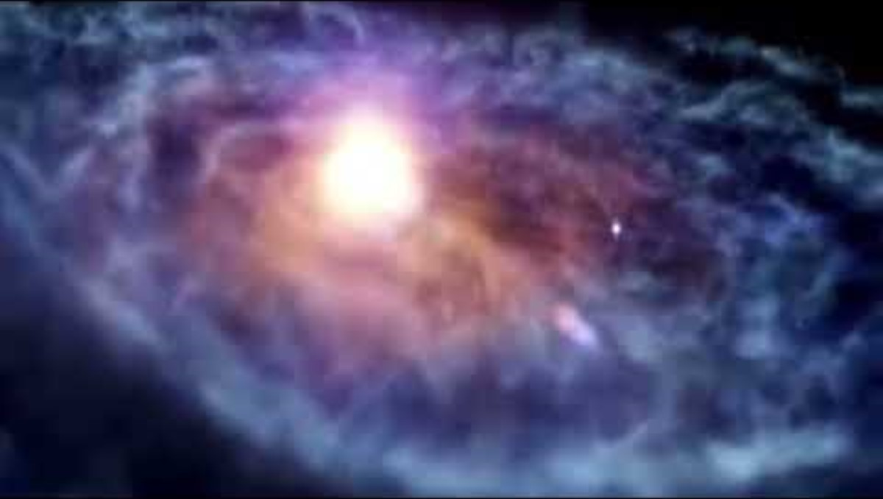
Notes:
You can insert any music here you wish. The video included here is a video made by Mthr Rose for a Diocese of Llandaff Advent prayer day.

Slide 20
God, we are going now, but we do not have to say goodbye to you; you are always with us. May we leave here today, with hope and joy, to face the future. We make our prayer through Jesus, your Son, who lives and reigns with you for ever.
+And the Blessing of God, Creator, Son and Holy Spirit be with you today and always. Amen.

Slide 21
Song:

Slide 22
Adapted from
S. Daly, http://www.timeforassembly.co.uk/leaversmass1.html
https://www.churchinwales.org.uk/en/publications/liturgy/
https://www.ofw-adelaide.org.au/uploads/1/2/3/2/123292439/eucharistic_prayers_for_masses_with_children__v4_.doc
https://www.churchinwales.org.uk/en/publications/liturgy/advent_presentation_christ/
With some original material by R Hill.

