Slide 1
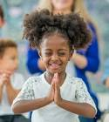
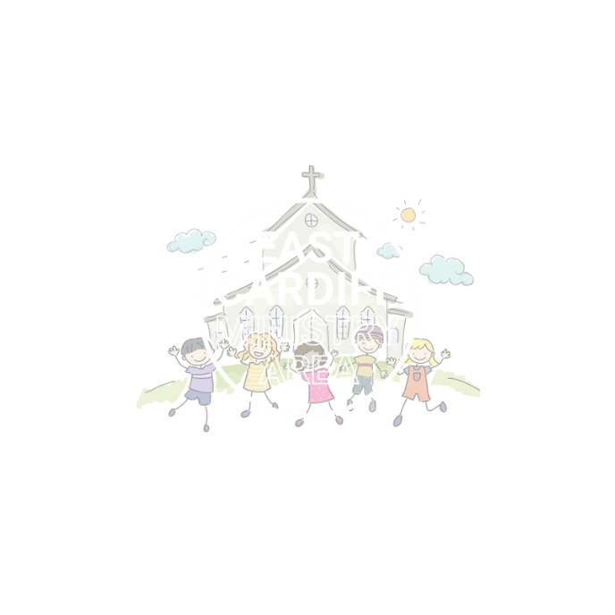
What is Prayer?
Monmouth diocesan vision: Discipleship

Slide 2
Think Pair Share
What do you think the word prayer means?

Slide 3
When we pray, we talk to God like we talk to a friend.
Close your eyes and imagine what God looks like.
There’s no right or wrong answer, you might visualize a person, animal or even just a warm Light

Slide 4
There is no right or wrong way to pray.
Some people like to pray with words and some people like to use their bodies

Slide 5
A really simple way to pray with our bodies is to make the sign of the cross.
By making the sign of the cross we remind ourselves that God is close to us and we are never alone.

Slide 6
We can also pray with words.
This can be as simple as imagining god or Jesus in your head and imagining telling God or Jesus all about your day, something you are thankful for or something you are worried about.

Slide 7
Jesus taught us a prayer that talks to God about our everyday wants and needs.
Here is a video of Grace, aged 8 saying the Lord’s Prayer

Slide 8
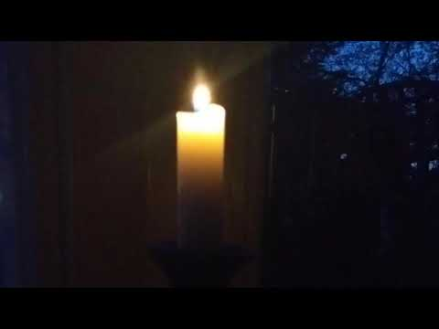

Slide 9
Our Father, who art in heaven, hallowed be thy name; thy kingdom come; thy will be done; on earth as it is in heaven. Give us this day our daily bread. And forgive us our trespasses, as we forgive those who trespass against us. And lead us not into temptation; but deliver us from evil. For thine is the kingdom, the power and the glory, for ever and ever. Amen.
Think Pair Share
Are there any words or phrases that stand out or you don't understand?

Slide 10
So let us pray
Lets prepare ourselves to pray:
Let’s make the sign of the cross
Take a moment to breathe and relax
Is there something you would like to tell God?
Our Father...

Slide 11
Our Father, who art in heaven, hallowed be thy name; thy kingdom come; thy will be done; on earth as it is in heaven. Give us this day our daily bread. And forgive us our trespasses, as we forgive those who trespass against us. And lead us not into temptation; but deliver us from evil. For thine is the kingdom, the power and the glory, for ever and ever. Amen.

