Slide 1
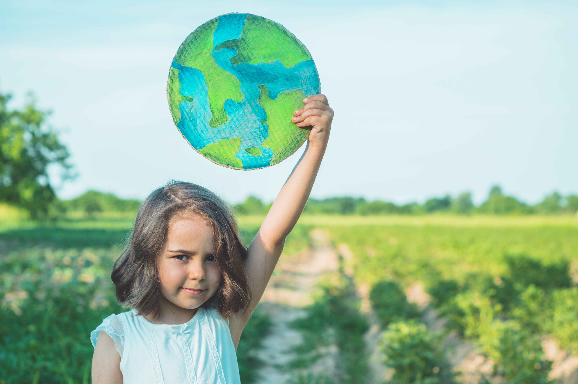
Springtime
Caring for God’s Creation

Slide 3
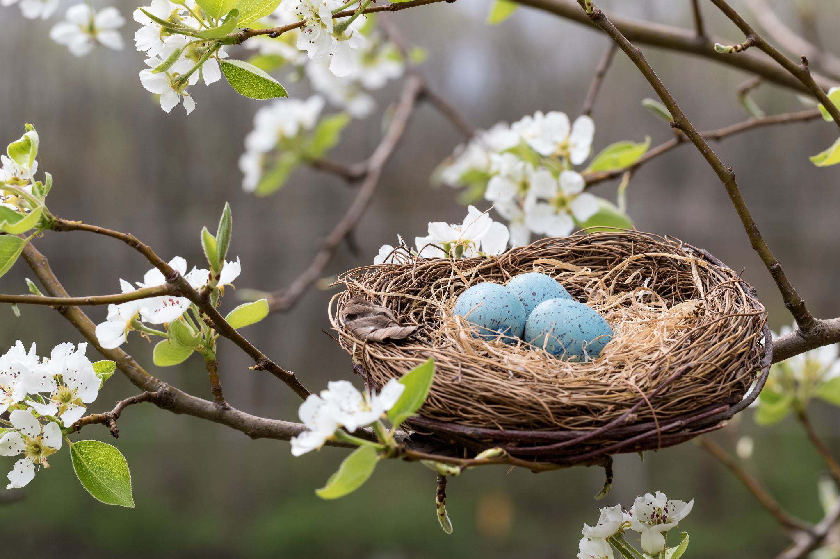
Discuss:
What signs of spring and Summer have you seen?

Slide 4
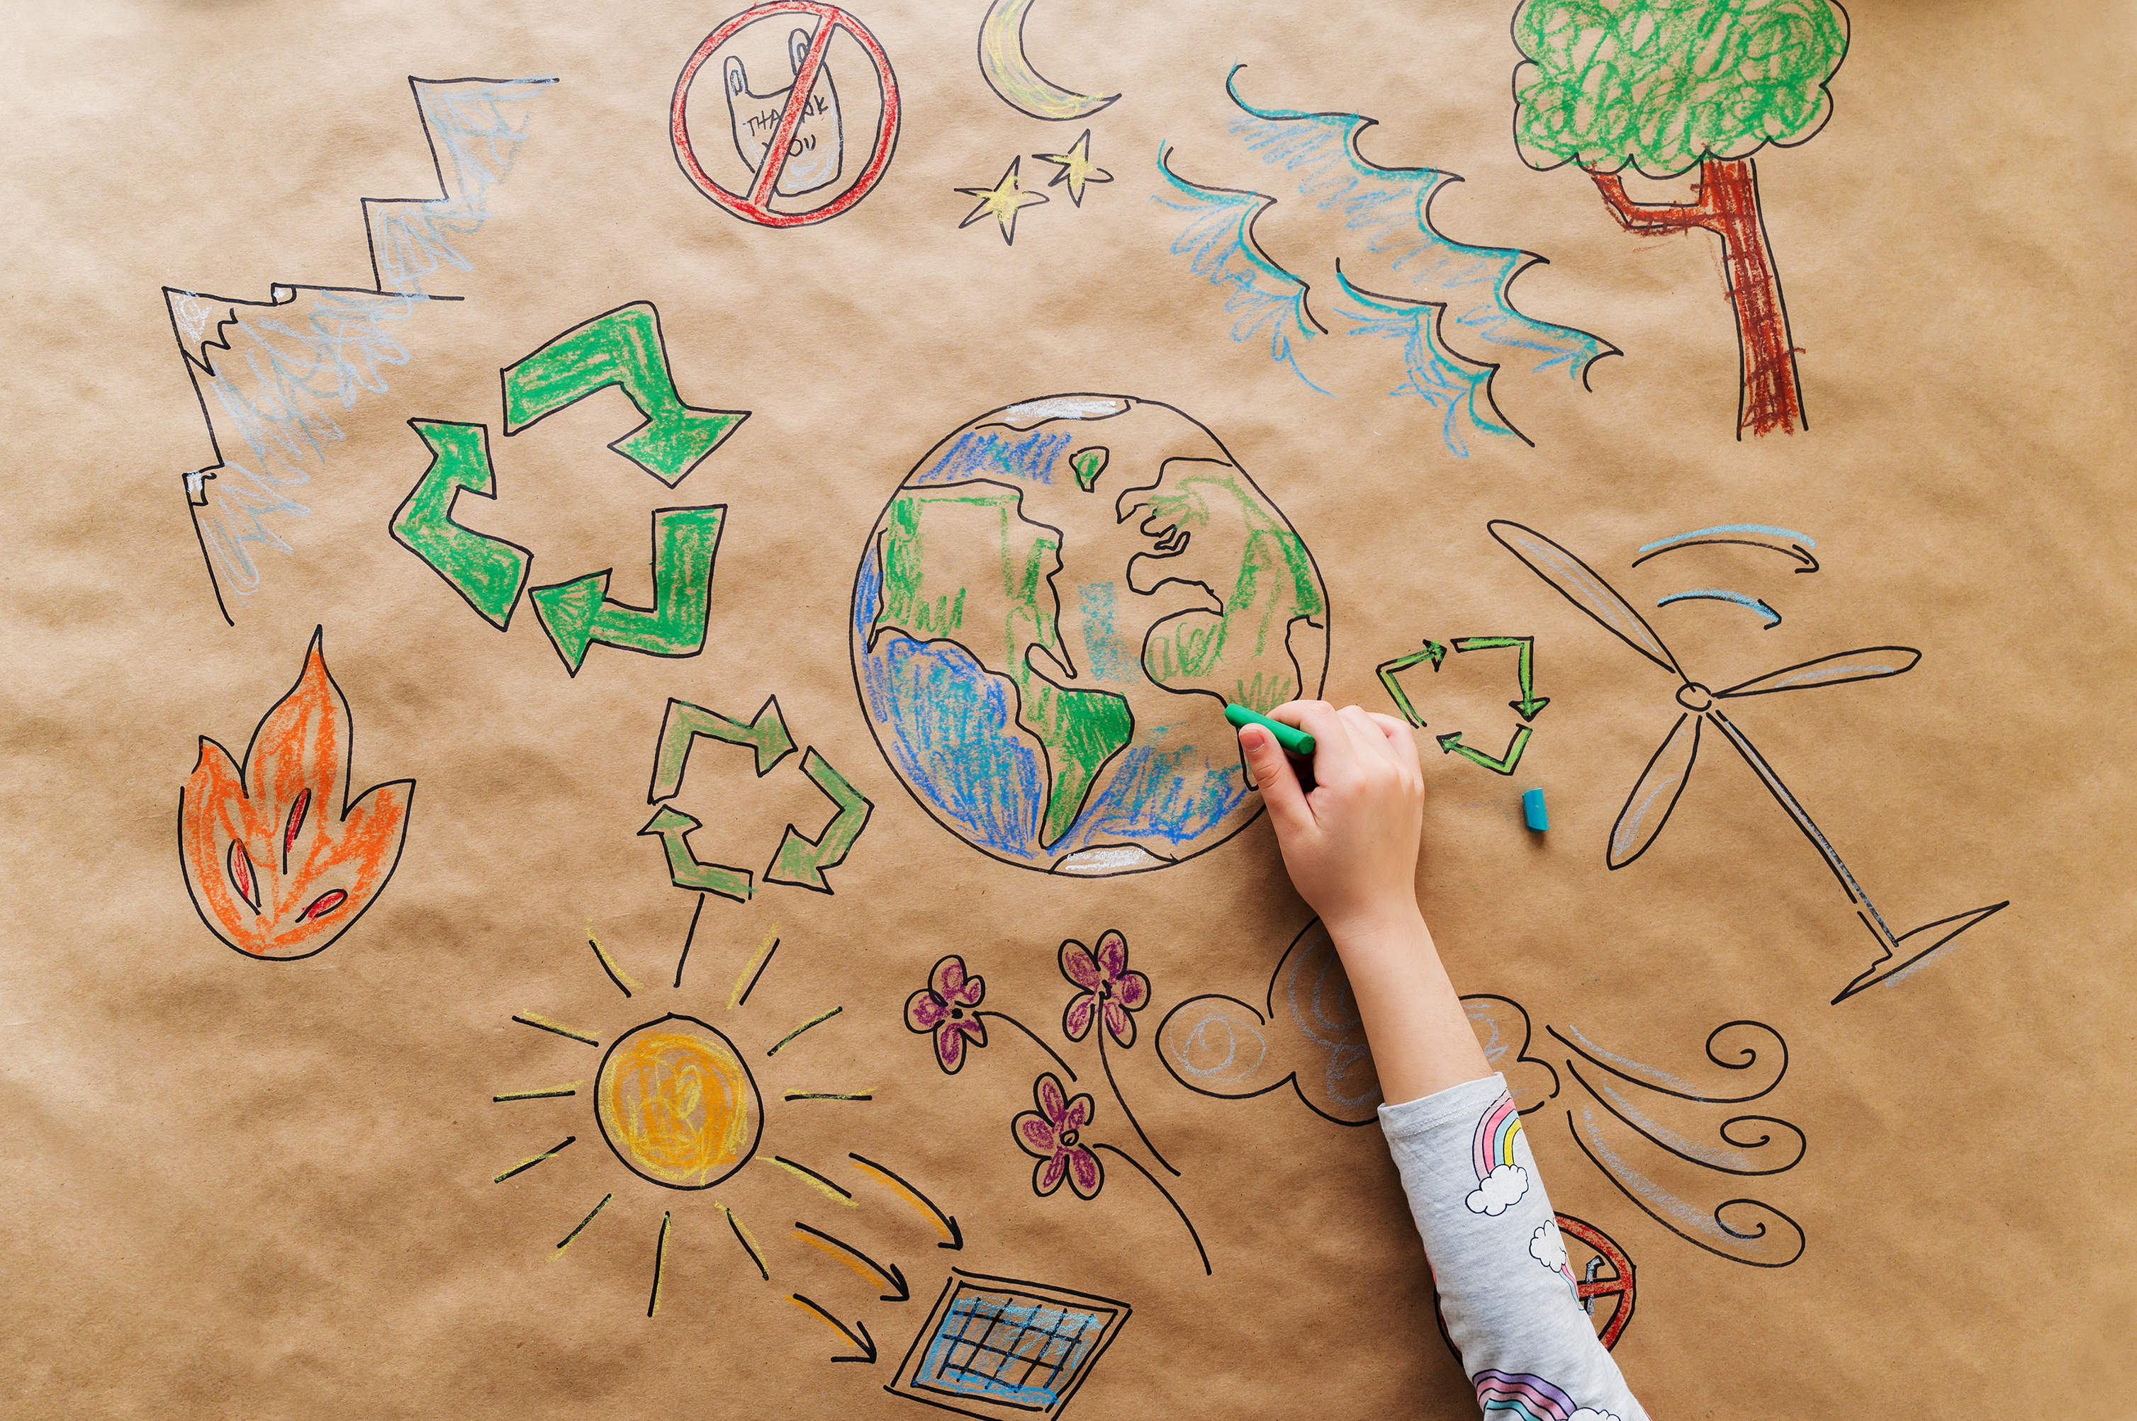
Think Pair share:
Do we always look after the world around us?
How can we protect god’s beautiful creation in our own small ways?

Slide 5
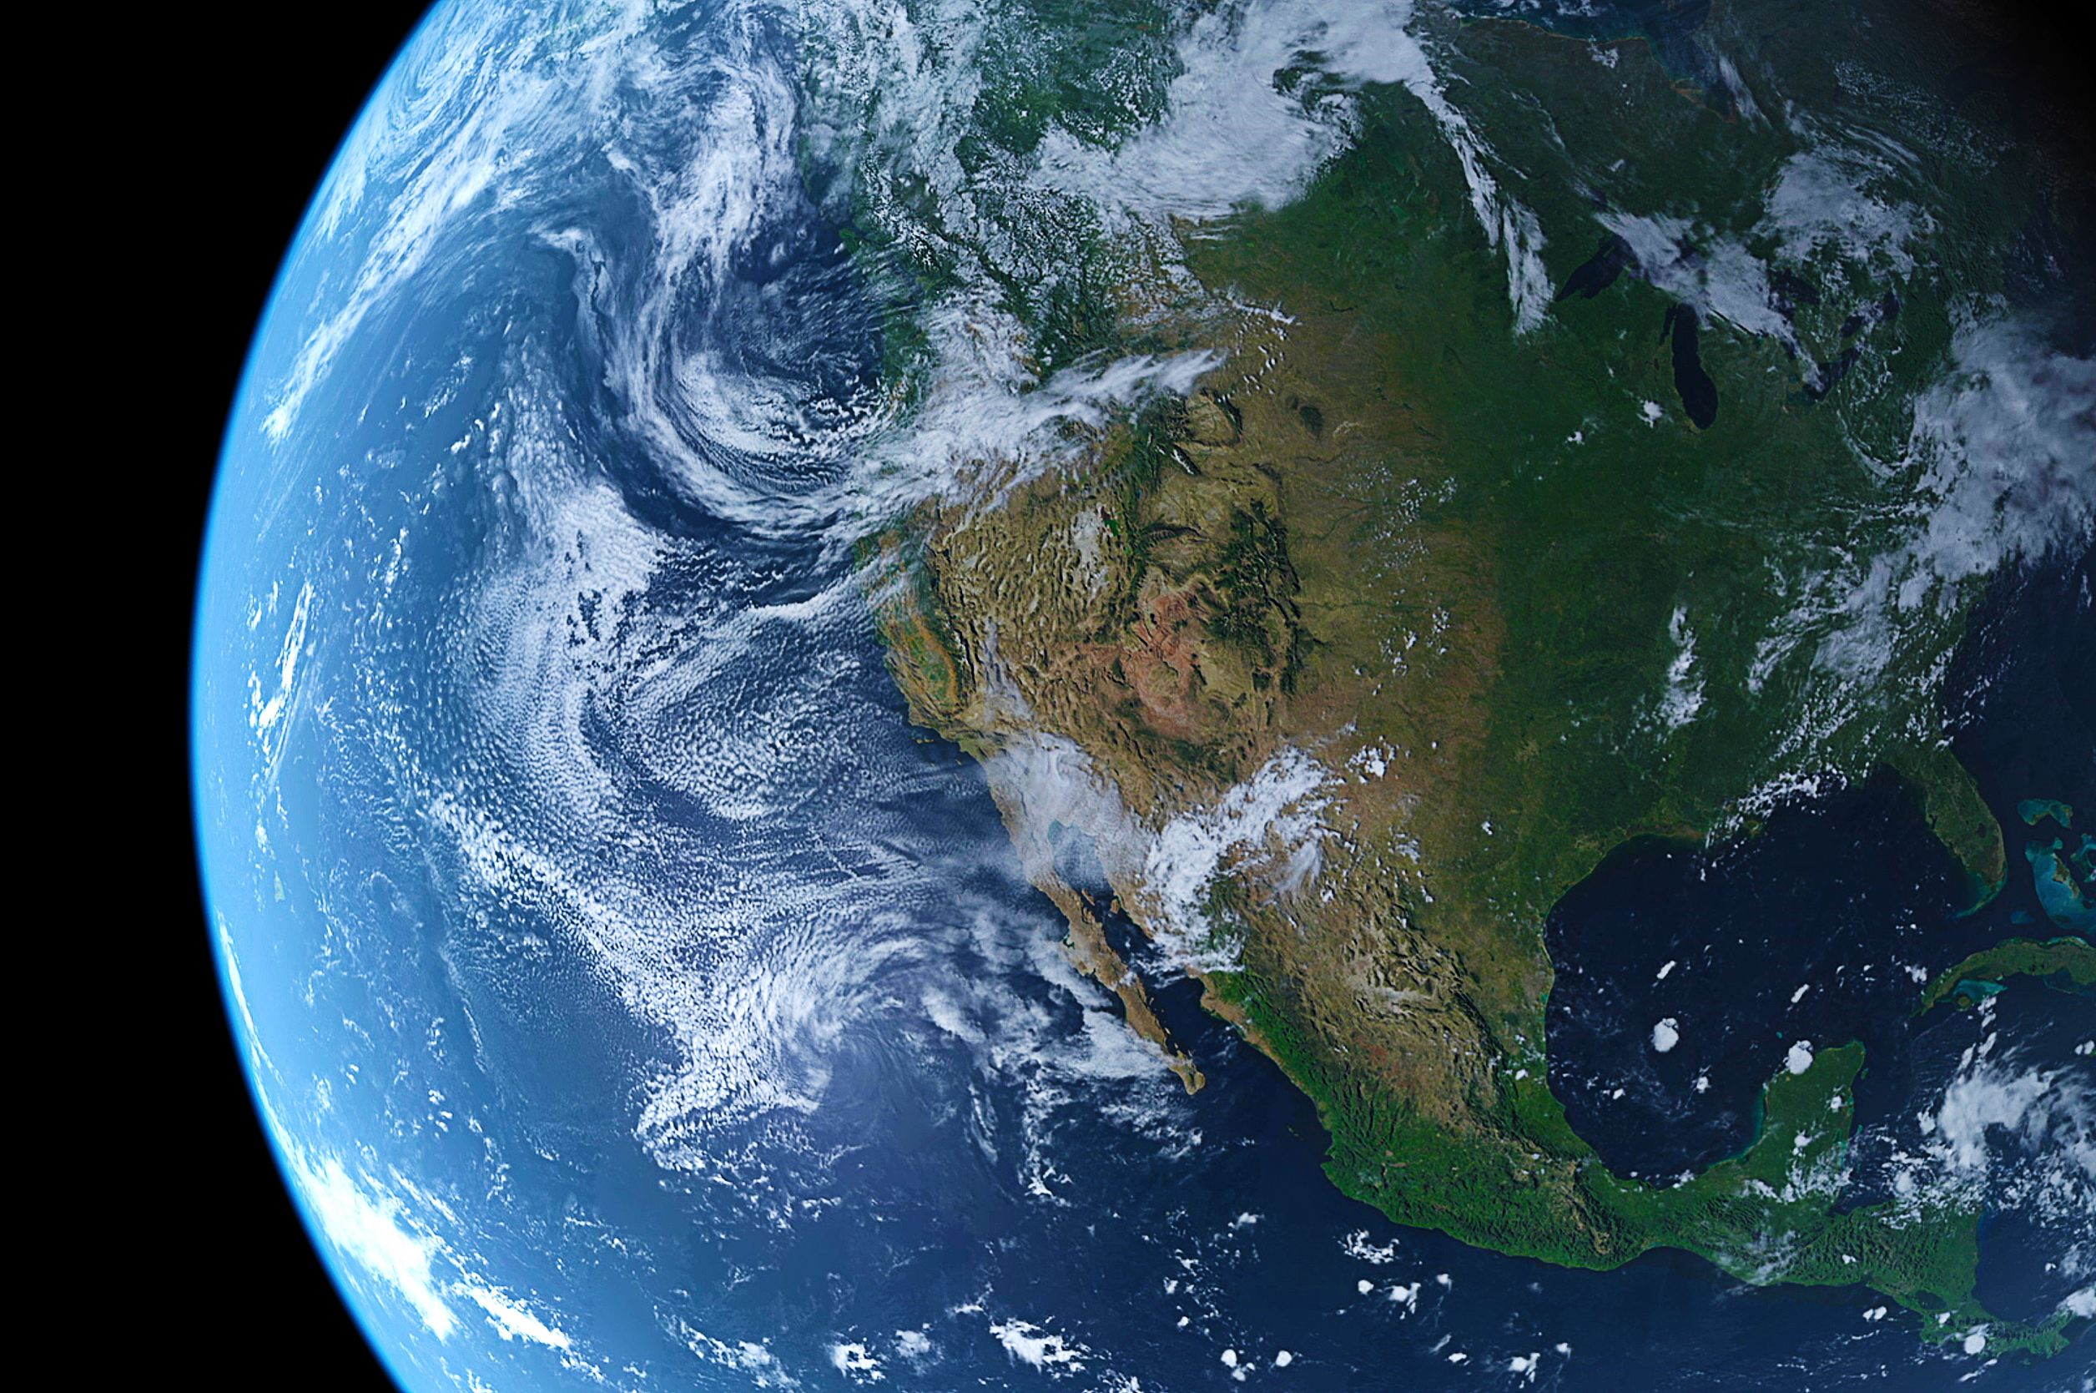
God saw everything that God had made, and indeed, it was very good.
(Genesis 1.31a)

Slide 6
Let us pray
Creator God, your love is shown in the flight of a bird, in the richness of soil, in the teeming oceans, in a human face. Thank you for the beauty of creation. Help me to look after your good earth. Amen

