Slide 1
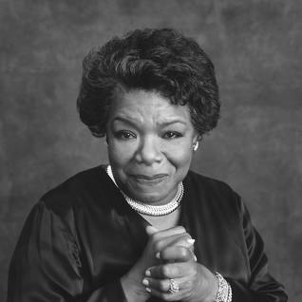
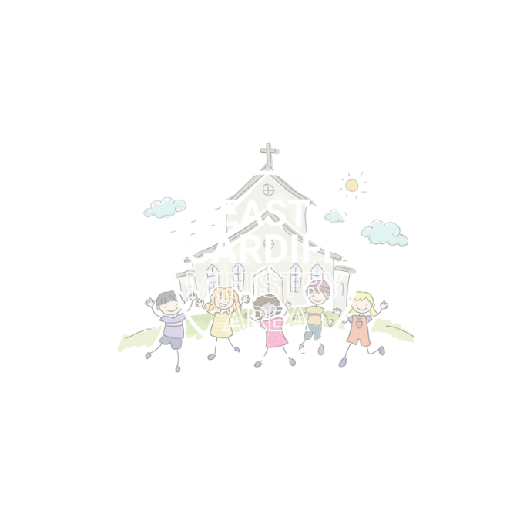
Speak Up
Courage
Monmouth diocesan vision: social justice

Slide 2
Discuss
What is courage?

Slide 4
Maya angelou
Maya Angelou was a very famous civil rights activist.
She became a famous English professor and also wrote many books about her life as a black, American woman

Slide 5
Discuss
The bible tells us in the book of micah that we should have courage and strive for ‘justice, and to love kindness, and to walk humbly with your God?’
As you watch the video think about how Maya angelou showed courage. How did she strive for justice, show love and be kind?

Slide 6
https://www.youtube.com/watch?v=SKy0TEwQAw4

Slide 7
Reflective exercise:
Close your eyes and imagine your week so far…
Have you noticed that something isn't fair or just in your school community?
E.g. rubbish not being put in bins, someone being unkind etc

Slide 8
Think-Pair-Share
How could you be courageous and help change something that isn’t fair or just?
e.g. tell someone to pick up their rubbish, tell a teacher if you see someone being unkind etc.

Slide 9
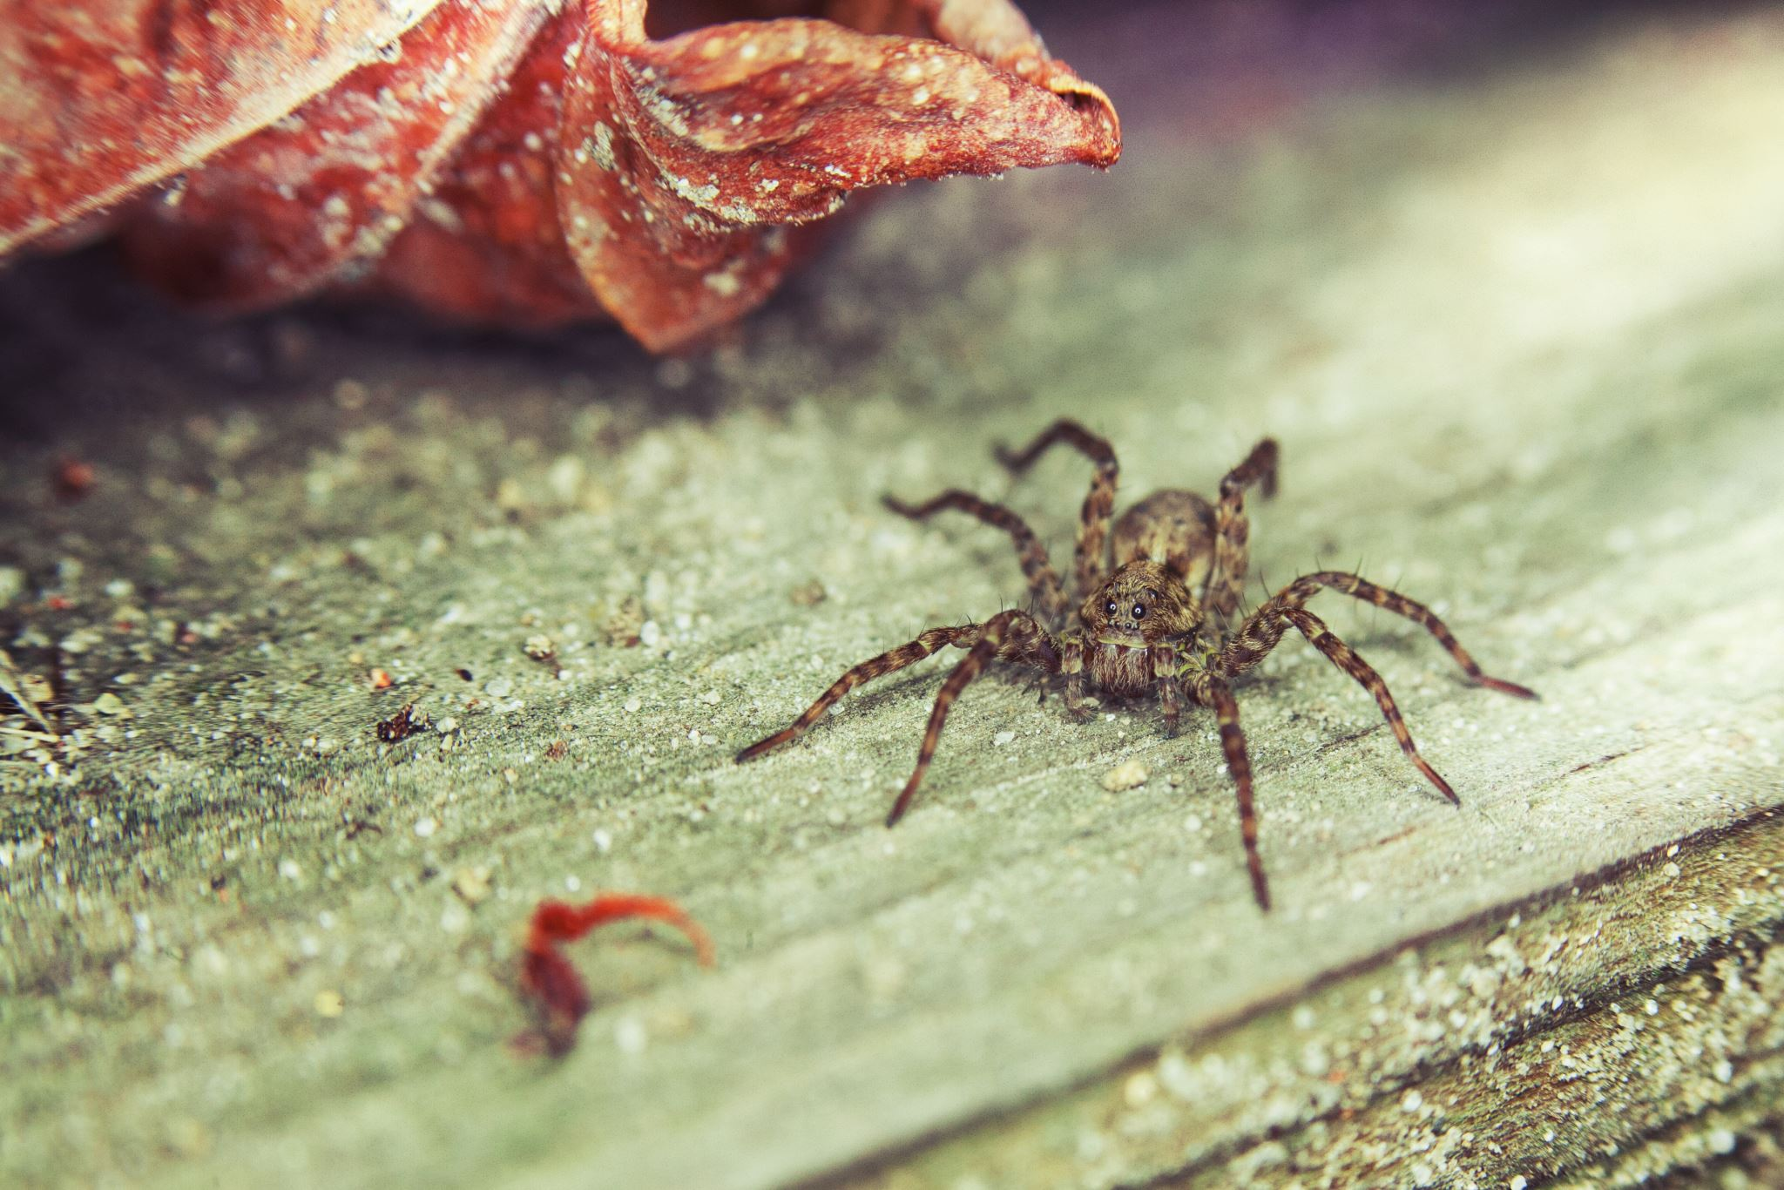
For EY/KS1
Anansi and the Sky Kingdom
Watch the Anansi story
How did Anansi and his friends show courage?
How can you show courage?
e.g. keep trying when you fail. Etc.

Slide 10
https://www.youtube.com/watch?v=4RHQYctGYkU
For EY/KS1

Slide 11
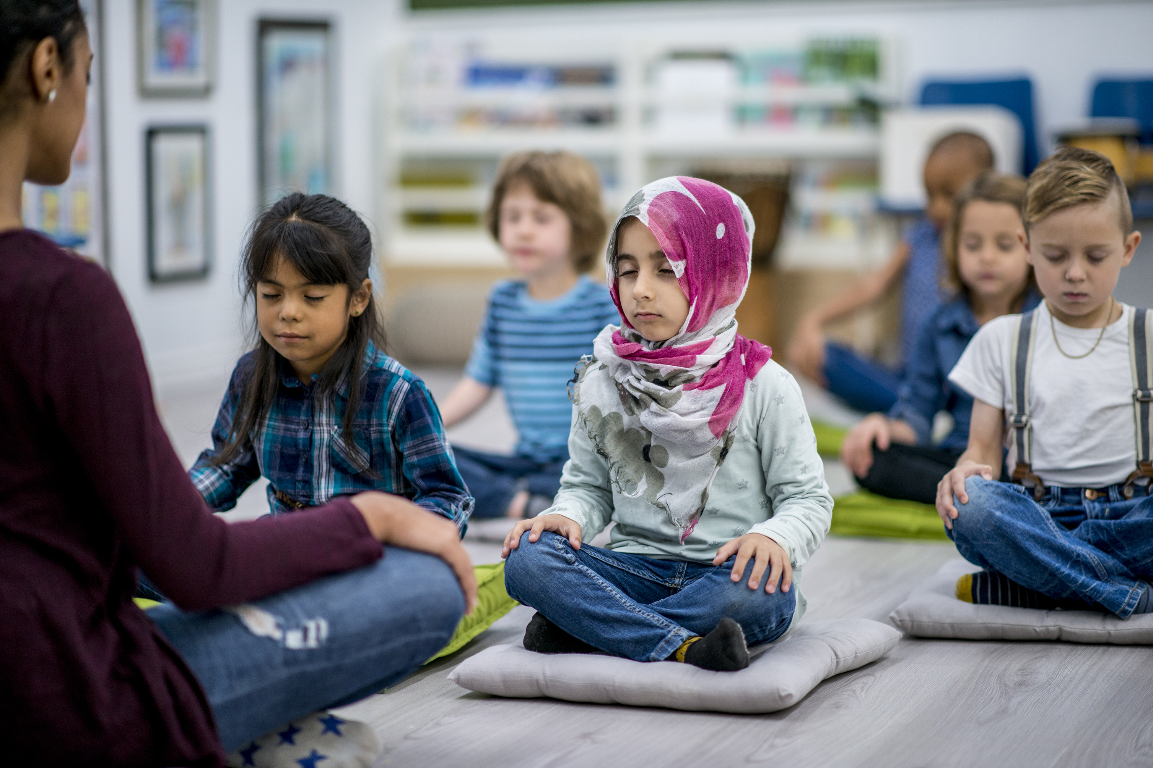
Let us pray
Imagine the big and small ways in which you show courage every day.
Lord of creation. Lift me up when I am unjustly treated. Forgive me when I act unjustly. Give me courage to speak up for those who are powerless. Save me from believing that change is not possible, Amen

