Slide 1
Never Give Up
Perseverance
Monmouth diocesan vision: Discipleship

Slide 2
Watch the video on the next slide and think about what it means to never give up.

Slide 4
Discuss:
What does it mean to never give up?
Can you think of some examples of not giving up?
Have you ever helped someone to persevere?

Slide 5
Perseverance means to never give up.
If we just keep going, even if we have to change the way we do things, eventually, we’ll complete our tasks.

Slide 6
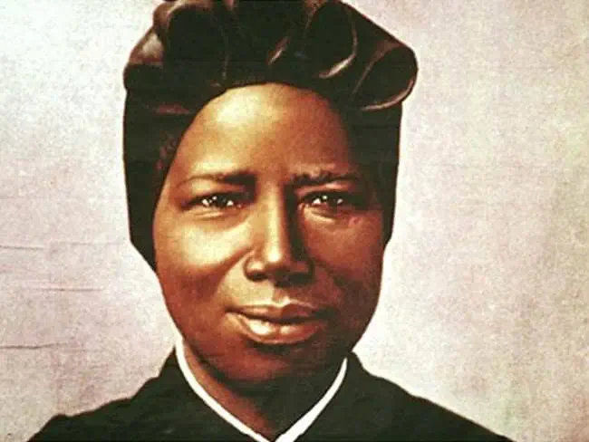
Saint Josephine Bakhita
St. Josephine Bakhita wanted to be a nun. When she was only a child she was Captured and made a slave in Sudan
To win her freedom and become a nun she had to find the courage to fight racism and injustice.
She had many setbacks and suffered a lot of hurt and nastiness from people, but she finally won her freedom and became a nun in 1896.
She became famous for never giving up and the kindness and compassion she showed to many children and adults who met her.

Slide 7
Discuss:
Saint Josephine spent much of her life helping others to never give up. How can you help people in your school or at home to never give up?

Slide 8
For EY/KS1
The Hare & The Tortoise
Ask students to act out the hare and the tortoise.
How could the Hare have helped the tortoise to persevere rather than make fun of him?
How can we help classmates to never give up?

Slide 9
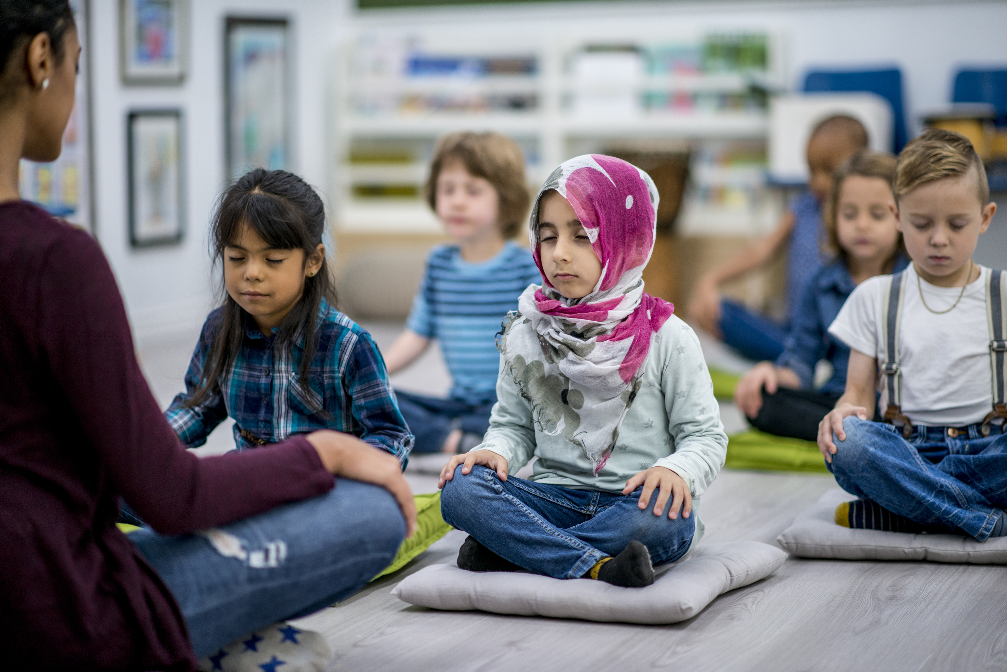
Let us pray
If you don’t want to pray. Imagine someone who helps you to never give up. Imagine thanking them and then thank them when you see them.
Jesus, draw me closer to you.
Help me to follow the example of Saint Josephine to never give up and to love you more deeply each day so that I can become like you.
Amen

Slide 10
For EY/KS1
Let us pray
IF YOU DON’T WANT TO PRAY. IMAGINE SOMEONE WHO HELPS YOU TO NEVER GIVE UP. IMAGINE THANKING THEM AND THEN THANK THEM WHEN YOU SEE THEM.
Jesus, help me to be more like you.
Help me to never give up help others to not give up.
Amen

