Slide 1
Moving On
Oh The places you will go!

Slide 2
Think Pair Share
What has been the best bit of this school year?
E.g. Trips, activities, events etc.

Slide 3
Think Pair Share
What are you looking forward to about next year?
E.g. Trips, activities, events, extra privileges etc.

Slide 4
Moving On
Sometimes we can feel worried about starting a new school year or a new school.
What type of things might we worry about?
How can we help ourselves to not feel quite so worried?

Slide 5
Oh The Places You Will Go!
Listen to this Poem by Dr Seuss which talks about our excitement and fears about growing up and moving on.

Slide 6
https://youtu.be/abw43kcLrbg

Slide 7
Do Not Be Afraid!
An old guy called Isaiah was inspired by God and wrote lots of stuff in The Bible. A lot of what he wrote can be summed up in the following verse he wrote.
Isaiah wrote:
‘Do Not Be Afraid, for I am with you’

Slide 8
Do Not Be Afraid!
‘Do Not Be Afraid, for I am with you’
When Isaiah wrote this he was saying that God can’t stop hard things happening because that is part of life, but that we won’t be alone when those things happen. There will always be someone we can turn to.

Slide 9
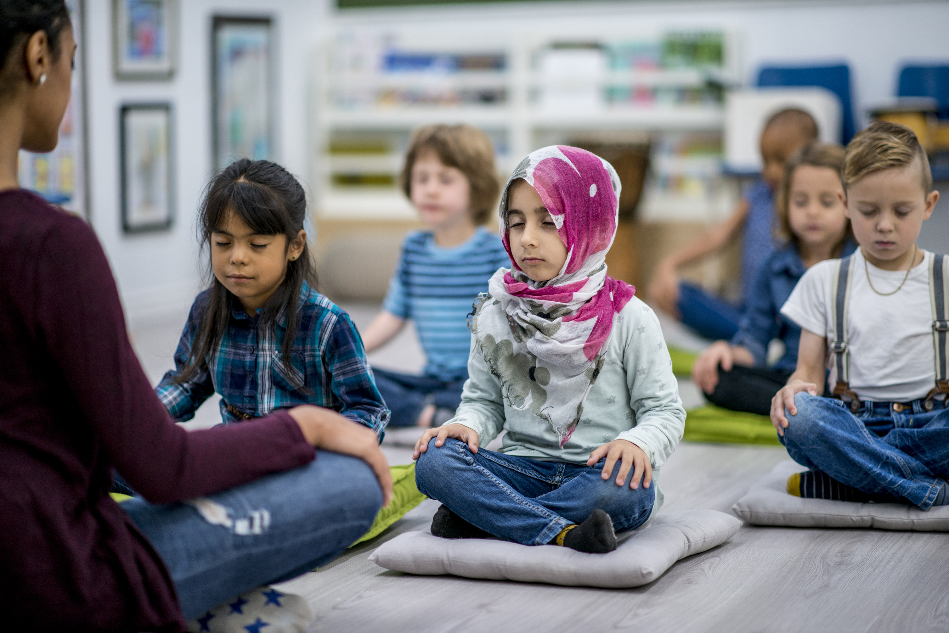
Let us pray
Close your eyes.
Imagine your first day of school in September, is there someone you know will be there to help you that day?
How can you be supportive of your friends and teachers in the new school year?
In your head, if you would like to, say thank you to God for the supportive and helpful people in your life.
If you see them later, maybe you could thank them in person.
Amen

