Slide 1
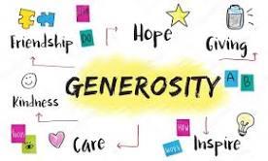
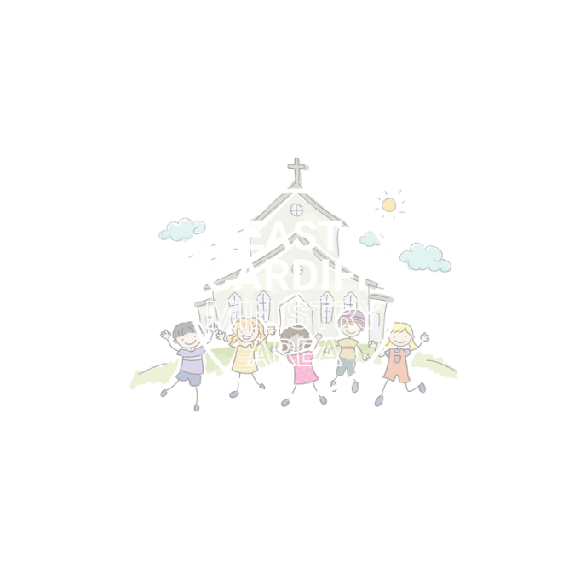
Lift Others Up
Generosity and Thankfulness
Monmouth diocesan vision: stewardship

Slide 3
Discuss:
What does it mean to be generous?
What does it mean to be thankful?

Slide 4
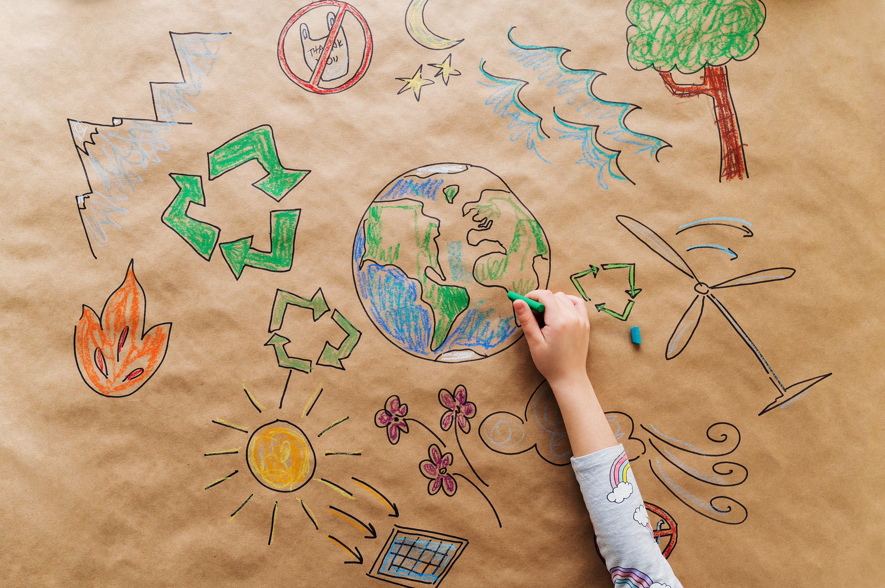
Grace is another word for generosity. It means the gifts we receive from god.
Grace is the most beautiful word in the language of God – it means love given freely and without expectation of return.
Justin Welby, Archbishop of canterbury

Slide 5
Discuss:
What are your graces? What are the gifts you have received? When we share our gifts we are generous and lift people up.
The best gifts in life are free. what is a gift you are thankful for and how can you be generous with your gifts to lift others up?
e.g. if you love to draw, maybe you could draw a picture to send to someone in a nursing home is lonely.
Remember your ideas must be free and safe.

Slide 6
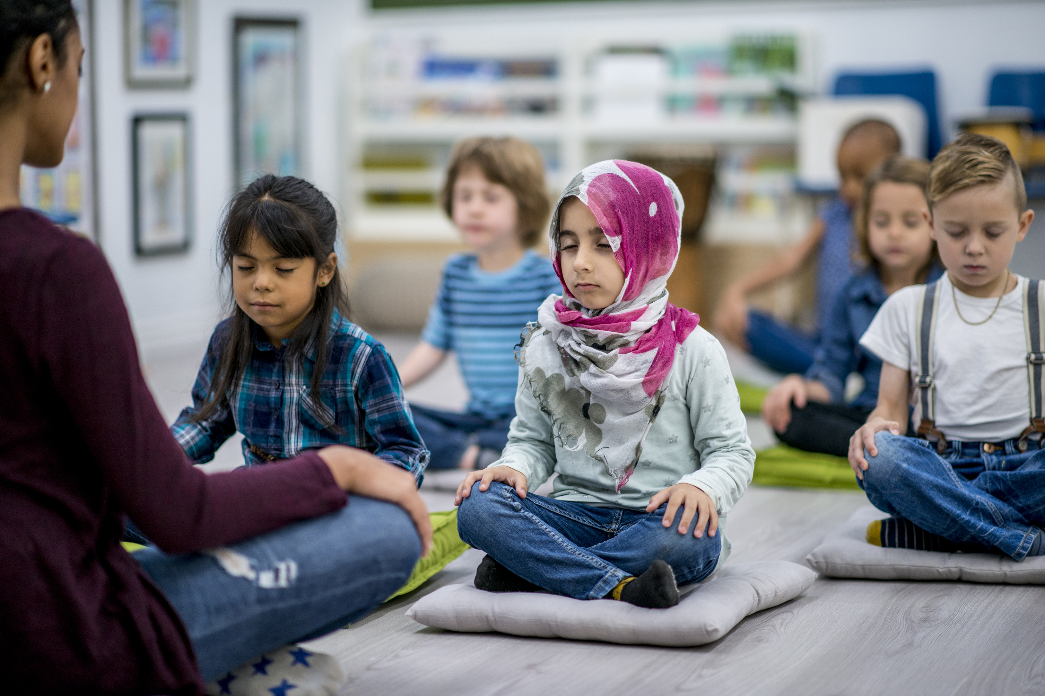
Let us pray
Generous God,
You pour your gifts on us.
Thank you for all that you have given us.
Help us to use our gifts well, for the good of all people, especially those who have little.
Amen

