Slide 1
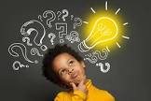
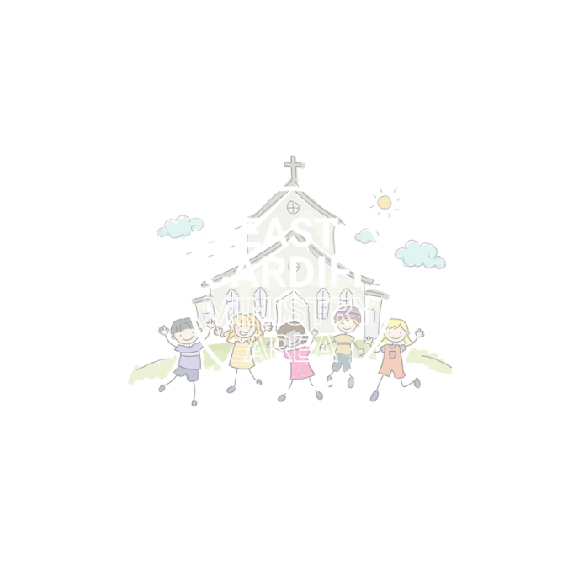
We are wonderfully made!
Welcoming all
Adapted from an assembly by LGBT Youth Scotland. The original can be found here:
https://mentallyhealthyschools.org.uk/resources/lgbt-youth-scotland-primary-assembly/

Slide 2
Give me a clue!

Slide 3
Discuss:
What does the word identity mean?

Slide 4
Pop and Olly video insert as browser
https://youtu.be/eRzRAh2M2Ao

Slide 5
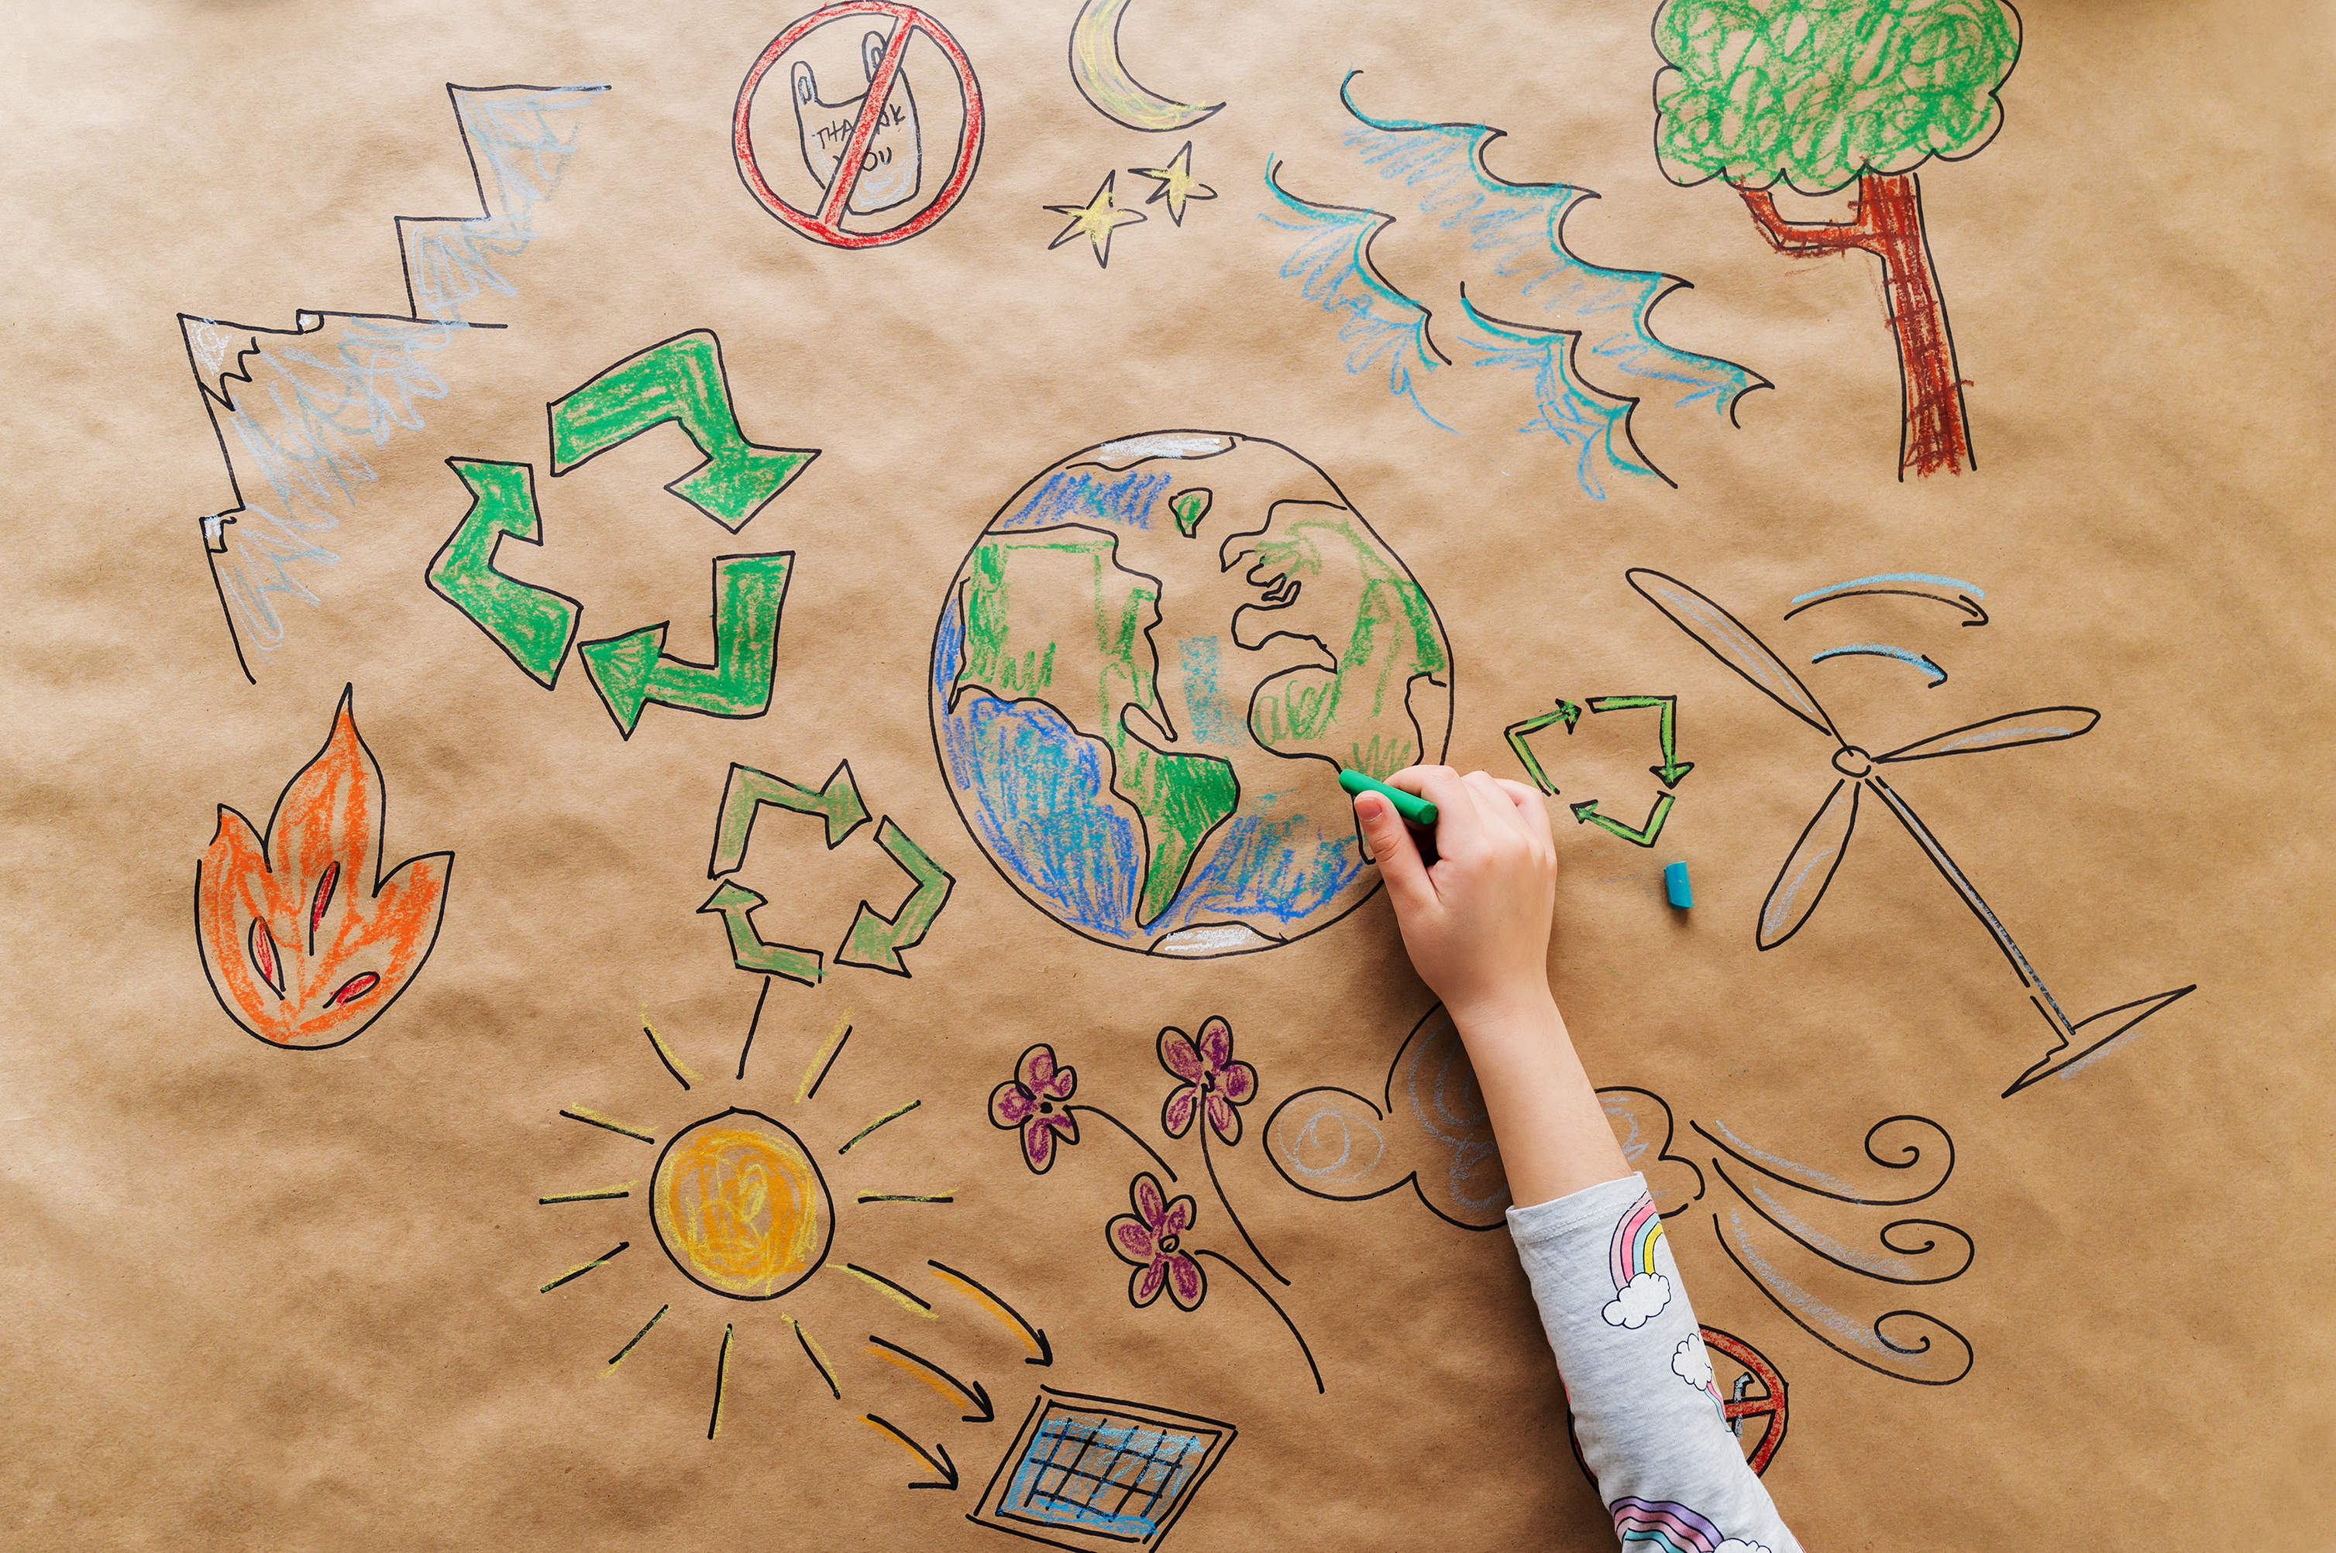
Think Pair share:
What makes you you? What’s your identity?

Slide 6
Think Pair share:
Can you think of a time somebody called you a name and made you sad?
Can you think of a time when somebody made you feel good about something to do with your identity?

Slide 7
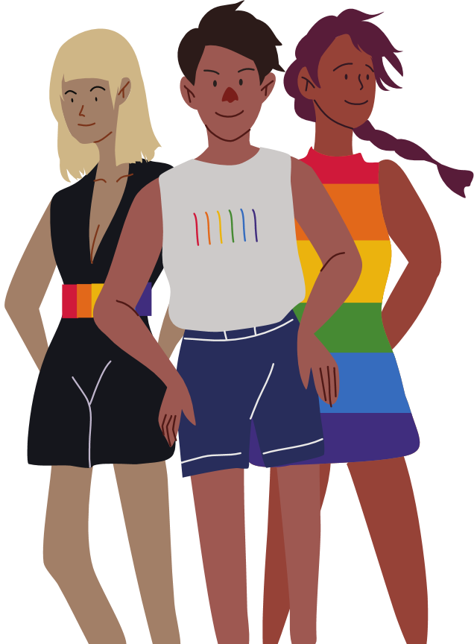
How do we create a safe space?
Jesus tells us to love one another and to treat others how we expect to be treated ourselves.
How can we make our communities a place where everybody feels loved?

Slide 8
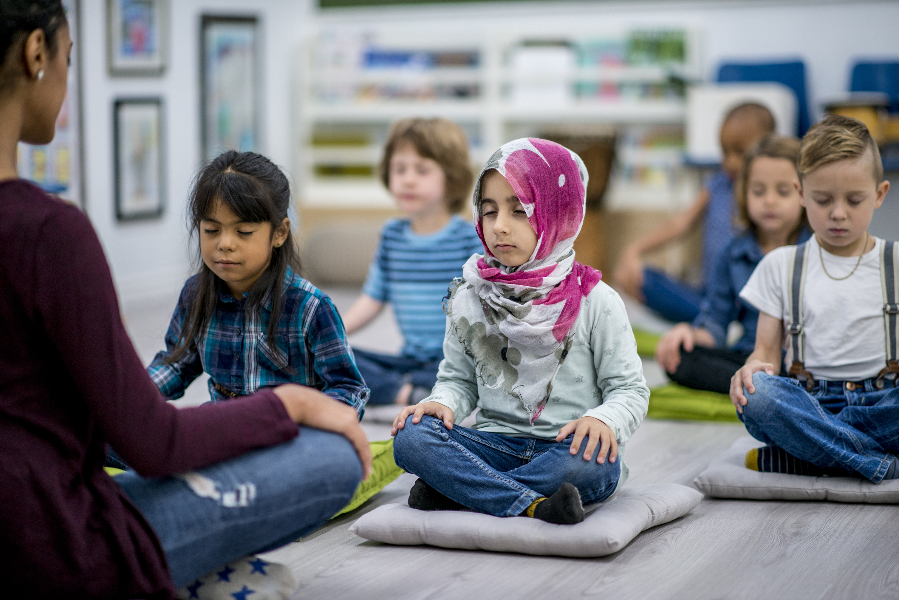
Let us pray
Let us pray:
Welcoming God. Help me to honour your image in every human being. Help me to know that I too reflect that image. May we offer your welcome to all.
Amen

