Slide 2
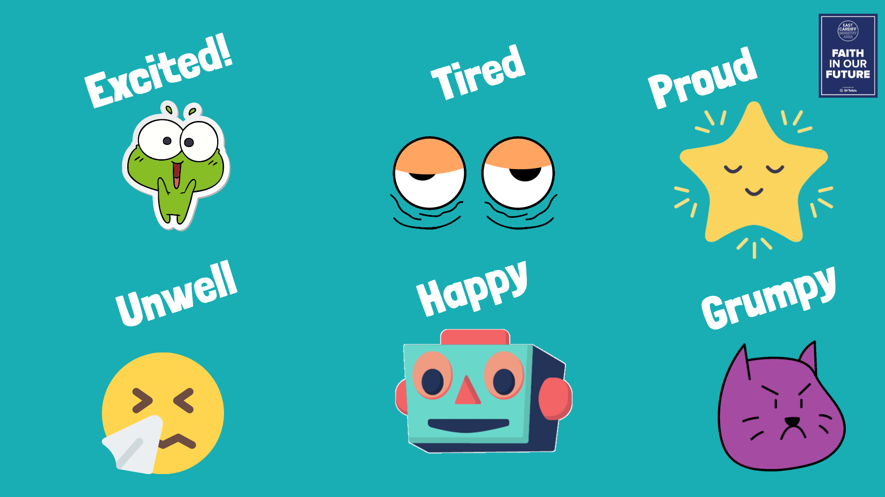

Slide 3
How did you feel when you came to school this morning?
What made you feel that way?
How can you share your feelings?
Nursery, Reception
&,
Key Stage 1

Slide 4
Can you think of the different moods or feelings that you might have when you come to school?
What might cause those moods or feelings?
Can you think of some of the ways that you can help yourself deal with those feelings (Good or not so good) or share those feelings?
Key Stage 2

Slide 5
Love is Patient, Love is Kind
1 CORINTHIANS 13.4

Slide 6
Time for Reflection

